Slide 1
PROJECT
Name : Mellow Reeba Thomas
Email : 213476@ust-global.com

Slide 2
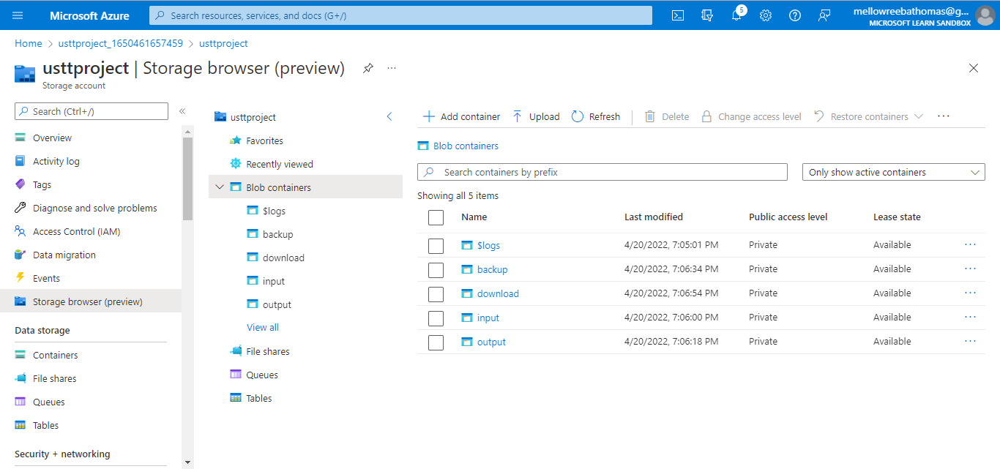
Storage Account in Azure with 4 containers(Input,Output,Backup,Download)

Slide 3
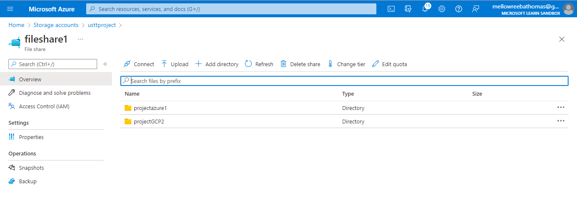
File Share with 2 Directories (Project Azure1,Project GCP2)

Slide 4
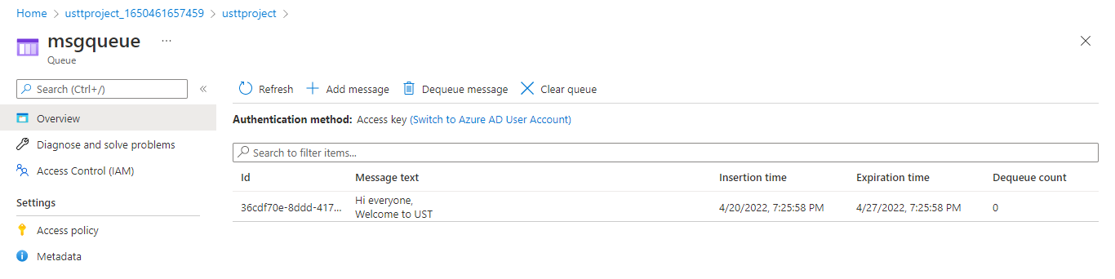
Message Queue with a Message

Slide 5
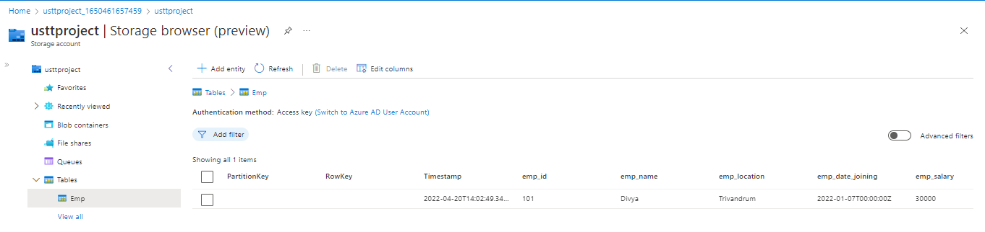
Table

Slide 6
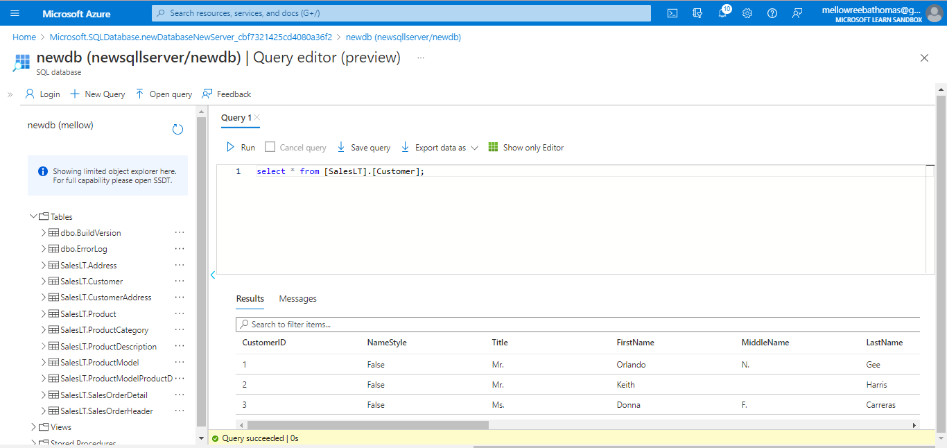
Sample Database with Query

Slide 7
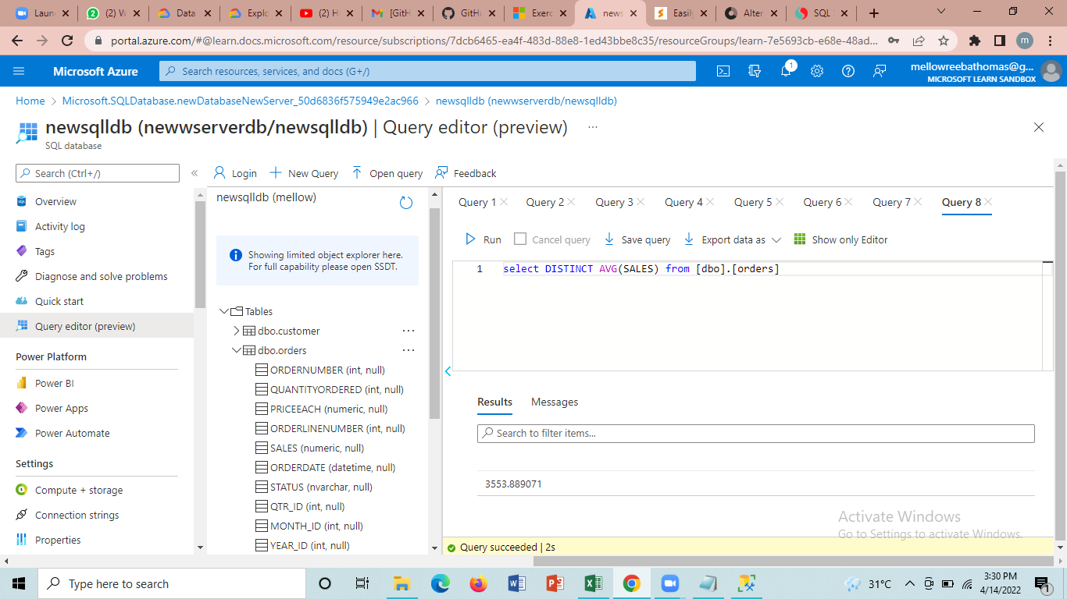
Sample Database with Dimensions and Fact Tables – To estimate the unit sales of retail goods

Slide 8
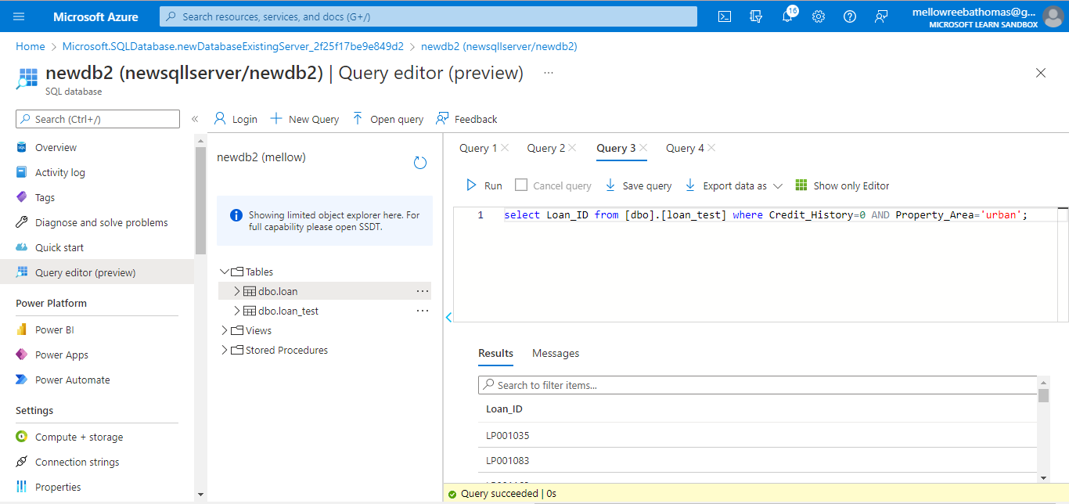
Sample Database with Dimensions and Fact Table – Financial Need Programs for Consumer Loan Products

